Slide 1
Guide to Computer Forensics and Investigations Sixth Edition Chapter 14
Report Writing for High-Tech Investigations
Notes:
Guide to Computer Forensics and Investigations Sixth Edition
Chapter 14
Report Writing for High-Tech Investigations

Slide 2
Objectives
Explain the importance of reports
Describe guidelines for writing reports
Explain how to use forensics tools to generate reports

Slide 3
Understanding the Importance of Reports (1 of 3)
Communicate the results of your investigation
Including expert opinion
Forensic reports can:
Provide justification for collecting more evidence
Be used at a probable cause hearing
Communicate expert opinion
U.S. district courts require expert witnesses to submit written reports
State courts are starting to also require them

Slide 4
Understanding the Importance of Reports (2 of 3)
Rule 26, Federal Rules of Civil Procedure requires submission of the expert’s written report that includes:
Testimony is based on sufficient facts or data
Testimony is the product of reliable principles and methods
Witness has applied the principles and methods reliably to the facts of the case
Written report must specify fees paid for the expert’s services
And list all other civil or criminal cases in which the expert has testified

Slide 5
Understanding the Importance of Reports (3 of 3)
Keep a copy of any deposition notice or subpoena so that you can include the following:
Jurisdiction
Style of the case
Cause number
Date and location of the deposition
Name of the deponent
Deposition banks
Examples of expert witness’ previous testimonies

Slide 6
Limiting a Report to Specifics
All reports to clients should start with the job mission or goal
Find information on a specific subject
Recover certain important documents
Recover certain types of files with specific dates and times
Before you begin writing, identify your audience and the purpose of the report

Slide 7
Types of Reports (1 of 4)
Digital forensics examiners are required to create different types of reports
Examination plan
What questions to expect when testifying
Attorney uses the examination plan to guide you in your testimony
You can propose changes to clarify or define information
Helps your attorney learn the terms and functions used in computer forensics

Slide 8
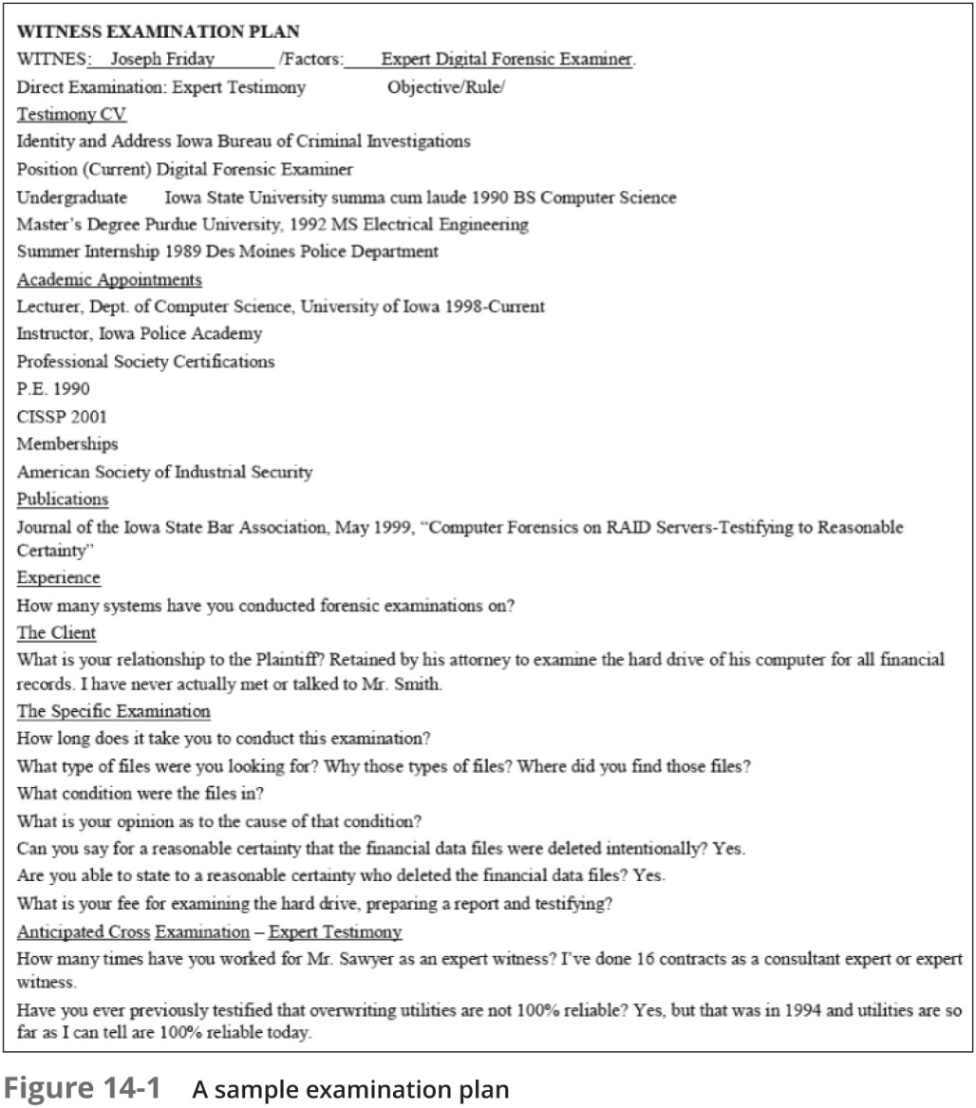
Types of Reports (2 of 4)

Slide 9
Types of Reports (3 of 4)
Verbal report
Less structured
Attorneys cannot be forced to release verbal reports
Preliminary report
Addresses areas of investigation yet to be completed
Tests that have not been concluded
Interrogatories
Document production
Depositions

Slide 10
Types of Reports (4 of 4)
Written report
Affidavit or declaration
Limit what you write and pay attention to details
Include thorough documentation and support of what you write

Slide 11
Guidelines for Writing Reports (1 of 2)
Hypothetical questions based on factual evidence
Guide and support your opinion
Can be abused and overly complex
Opinions based on knowledge and experience
State the facts needed to answer the question
Don’t include any unnecessary facts

Slide 12
Guidelines for Writing Reports (2 of 2)
As an expert witness, you may testify to an opinion or conclusion, if four basic conditions are met:
Opinion, inferences, or conclusions depend on special knowledge, skills, or training
Witness should qualify as a true expert in the field
Witness must testify to a reasonable degree of certainty
Experts must know facts on which their opinions are based, or they must testify to a hypothetical question

Slide 13
What to Include in Written Preliminary Reports (1 of 2)
Anything you write down as part of your examination for a report
Subject to discovery from the opposing attorney
Discovery: the process of opposing attorneys seeking information from each other
Written preliminary reports are considered high-risk documents
It’s better if there’s no written report to provide
Destroying the report could be considered destroying or concealing evidence (spoliation)

Slide 14
What to Include in Written Preliminary Reports (2 of 2)
Include the same information as in verbal reports
Additional items to include in your report:
Summarize your billing to date and estimate costs to complete the effort
Identify the tentative conclusion (rather than the preliminary conclusion)
Identify areas for further investigation and get confirmation from the attorney on the scope of your examination

Slide 15
Report Structure (1 of 2)
Structure
Abstract (summary)
Table of contents
Body of report
Conclusion
References
Glossary
Acknowledgements
Appendixes

Slide 16
Report Structure (2 of 2)
An abstract condenses the report to concentrate on the essential information
The body consists of the introduction and discussion sections
The conclusion starts by referring to the report’s purpose, states the main points, draws conclusions, and possibly renders an opinion
References and appendixes list the supporting material to which your work refers

Slide 17
Writing Reports Clearly (1 of 3)
Consider
Communicative quality
Ideas and organization
Grammar and vocabulary
Punctuation and spelling
Lay out ideas in logical order
Build arguments piece by piece
Group related ideas and sentences into paragraphs
Group paragraphs into sections

Slide 18
Writing Reports Clearly (2 of 3)
Avoid jargon, slang, and colloquial terms
Define technical terms
Consider your audience
Considering writing style
Use a natural language style
Avoid repetition, vague language, and generalizations
Use active rather than passive voice
Avoid presenting too many details and personal observations

Slide 19
Writing Reports Clearly (3 of 3)
Considering writing style (cont’d)
Project objectivity
Communicate calm, detached observations
Including signposts
Draw reader’s attention to a point
Assist readers in scanning the text quickly by highlighting the main points and logical development of information

Slide 20
Designing the Layout and Presentation of Reports (1 of 4)
Two numbering systems are typically used
Decimal numbering structure
Divides material into sections
Readers can scan heading
Readers see how parts relate to each other
Legal-sequential numbering
Used in pleadings
Roman numerals represent major aspects
Arabic numbers are supporting information

Slide 21
Designing the Layout and Presentation of Reports (2 of 4)
Providing supporting material
Use material such as figures, tables, data, and equations to help tell the story as it unfolds
Formatting consistently
How you format text is less important than being consistent in applying formatting
Explaining examination and data collection methods
Explain how you studied the problem, which should follow logically from the report’s purpose

Slide 22
Designing the Layout and Presentation of Reports (3 of 4)
Including calculations
If you use any hashing algorithms, be sure to give the common name
Providing for uncertainty and error analysis
Protect your credibility
Explaining results and conclusions
Explain your findings, using subheadings to divide the discussion into logical parts
Save broader generalizations and summaries for the report’s conclusion

Slide 23
Designing the Layout and Presentation of Reports (4 of 4)
Providing references
Cite references by author’s last name and year of publication
Follow a standard format
Including appendixes
You can include appendixes containing material such as raw data, figures not used in the body of the report, and anticipated exhibits
Arrange them in the order referred to in the report

Slide 24
Generating Report Findings with Forensics Software Tools
Forensics tools generate reports when performing analysis
It is still your responsibility to explain the significance of the evidence
Report formats
Plaintext
Word processor
Spreadsheet
HTML format

Slide 25
Using Autopsy to Generate Reports (1 of 4)
Follow Activity steps starting on page 575

Slide 26
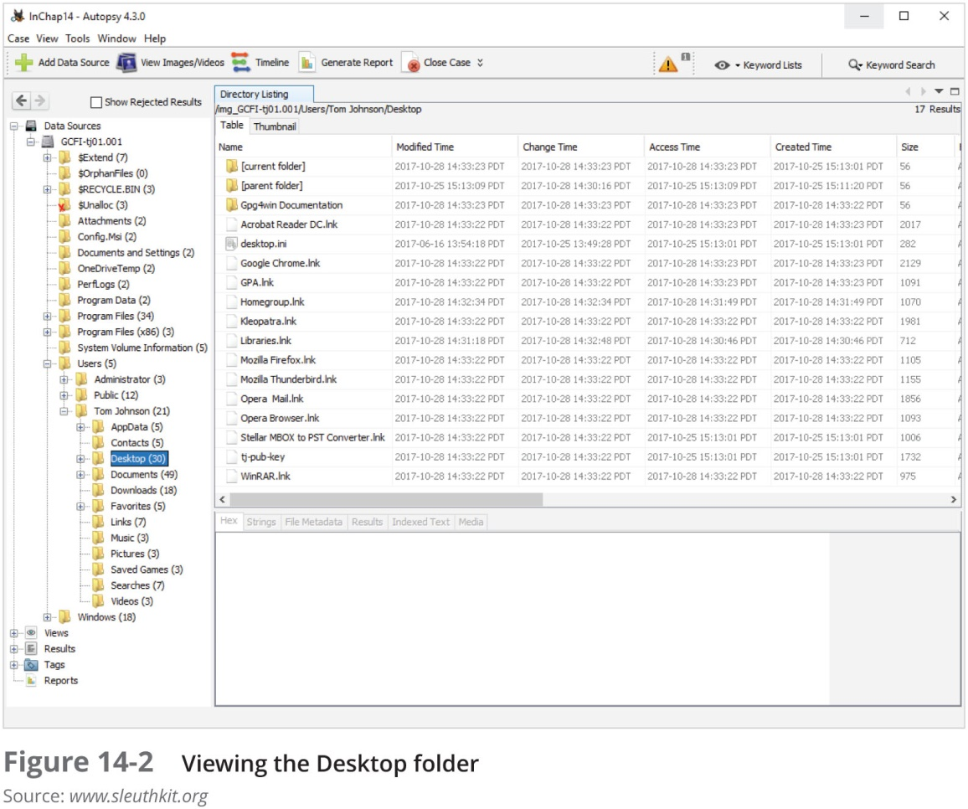
Using Autopsy to Generate Reports (2 of 4)

Slide 27
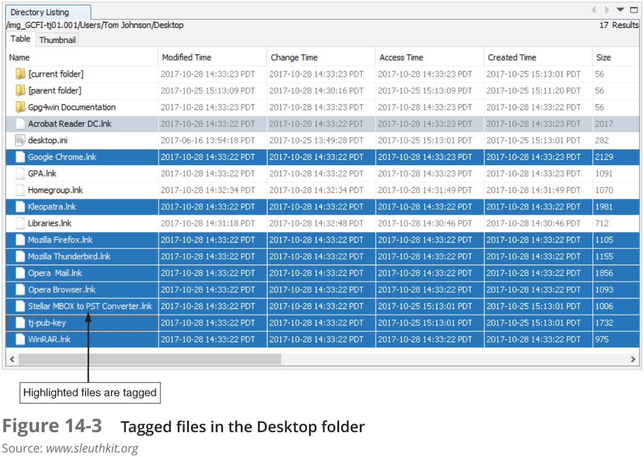
Using Autopsy to Generate Reports (3 of 4)

Slide 28
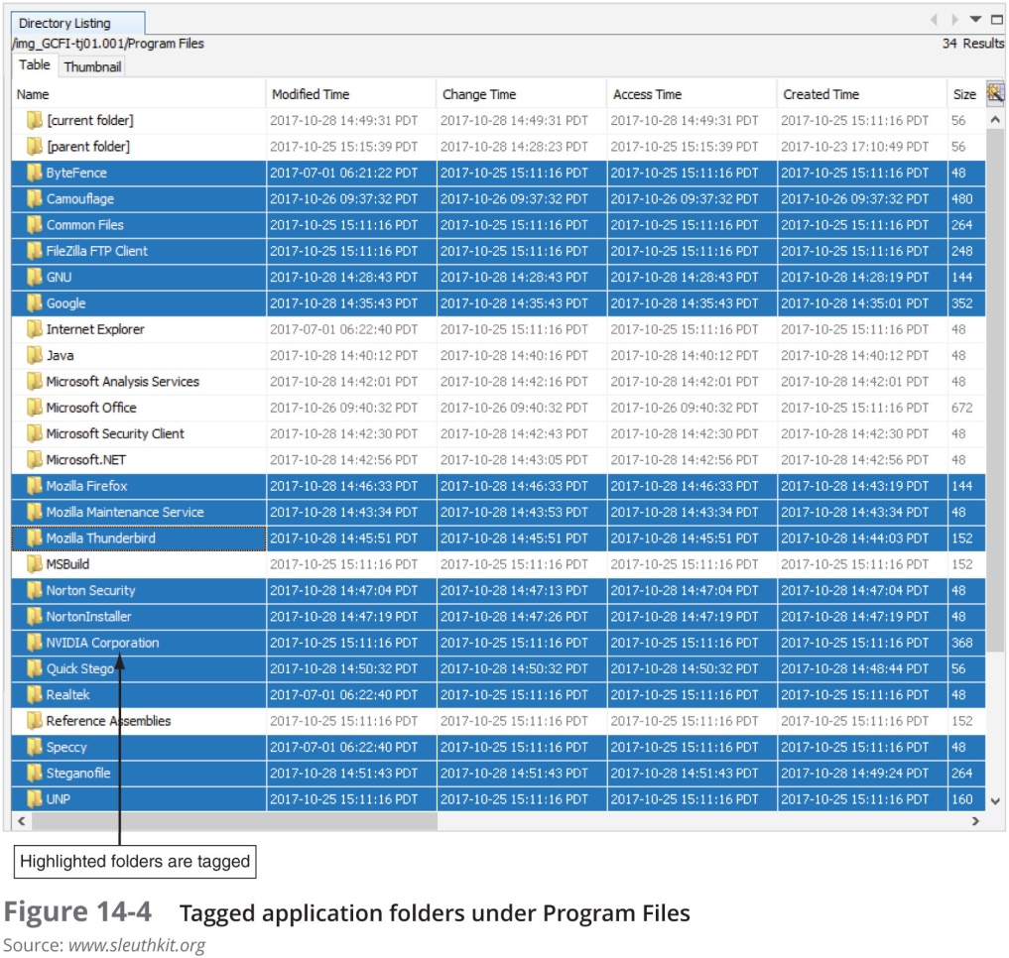
Using Autopsy to Generate Reports (4 of 4)

Slide 29
Summary (1 of 2)
All U.S. district courts and many state courts require expert witnesses to submit written reports
Rule 26 of the FRCP requires expert witnesses who anticipate testifying to submit written reports
Attorneys use deposition banks to research expert witnesses’ previous testimony
Reports should answer the questions you were retained to answer

Slide 30
Summary (2 of 2)
A well-defined report structure contributes to readers’ ability to understand the information you’re communicating
Clarity of writing is critical to a report’s success
Convey a tone of objectivity and be detached in your observations

